Slide 1
Programming With C and Python for Newbies
Day 7: Introduction into Python, syntax and its data types

Slide 2
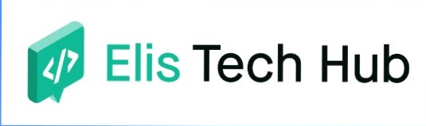
Introduction into Python
Python is a high-level, general-purpose interpreter programming language that executes the source code one at a time i.e runs it line by line or from top to bottom
Source code
Interpreter
Output

Slide 3
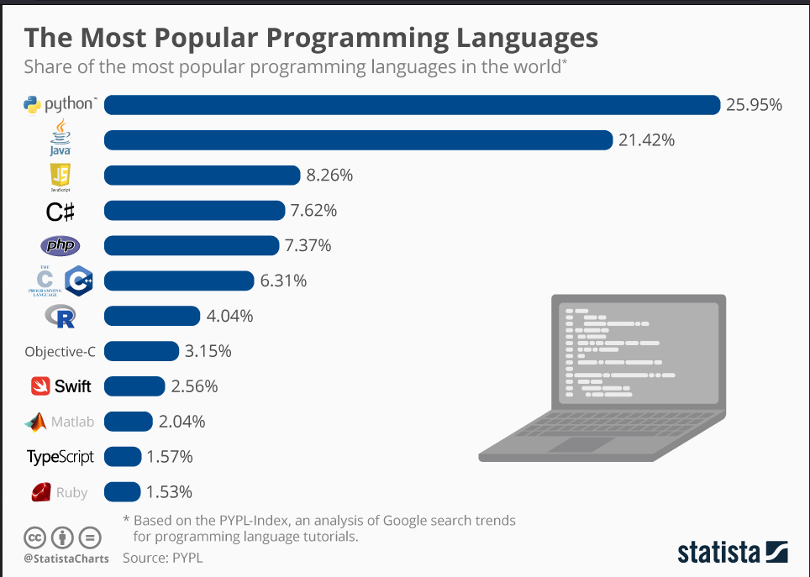

Slide 4
Installing Python

Slide 5
Writing our first program in Python

Slide 6
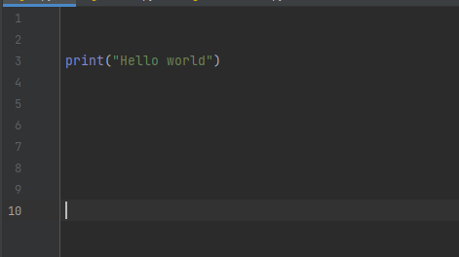
Writing our first program
As its our norm, our first program will be to print our “Hello world.”

Slide 7

Data types in Python
This are the kind of data a variable can hold:
Integer e.g 1,23,53,-3
String e.g “club”, “Love”, ‘blue’
Float e.g 333.2311, 0.034,
Boolean e.g True,False

